Slide 1
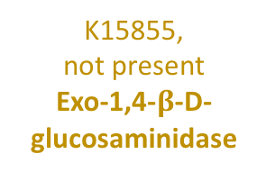
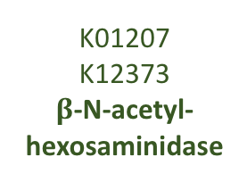
K01183
Chitinase
Chitin
Chitobiose
N-acetyl-D-glucosamine
N-acetyl-D-glucosamine-6-phosphate
K01183
Chitinase
K01207
K12373
$β$-N-acetyl-hexosaminidase
K00884
N-acetyl- glucosamine kinase
K01452
Chitin deacetylase
K01443
N-acetyl-glucosamine-6-phosphate deacetylase
Chitosan
D-glucosaminide
D-glucosamine
D-glucosamine-6-phosphate
K01233,
not present
Chitosanase
K15855,
not present
Exo-1,4-$β$-D-glucosaminidase
K00884
K18676
Hexokinase, Glucosamine kinase
K02564
Glucosamine-6-phosphate deaminase
Fructose-6-phosphate

